Slide 1
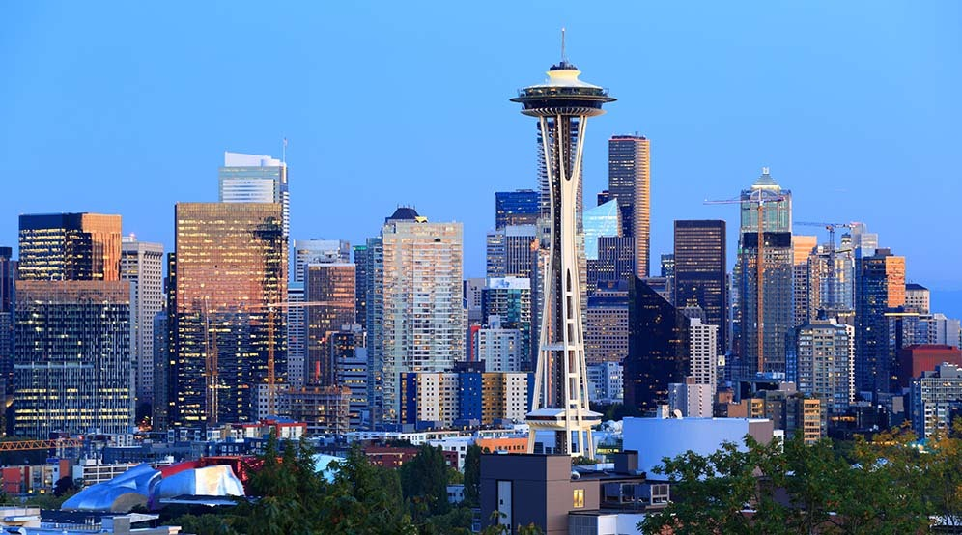
Seattle, Washington Real Estate
Presentation by Hermione Granger

Slide 2
Objectives
Create a model to predict price based on features.
Using BI tools, explore the property features in this dataset.
Understanding the factors responsible for high property values.

Slide 3
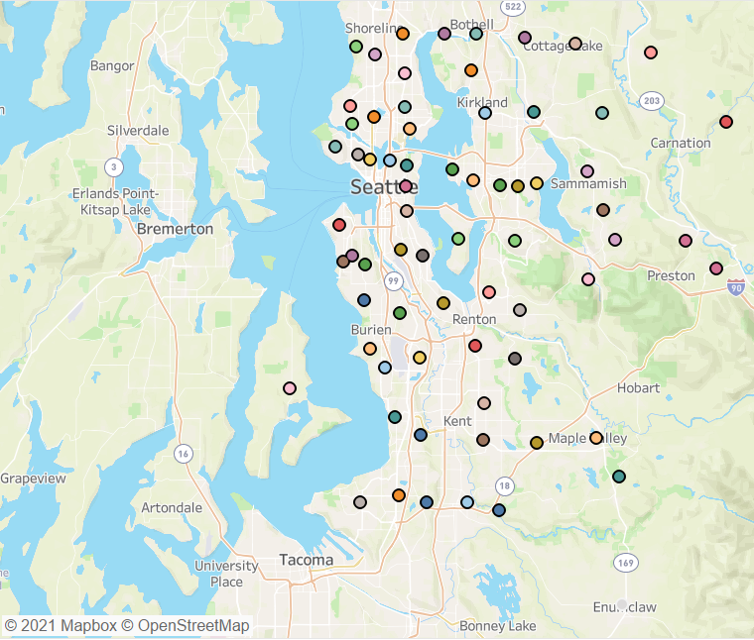
The Data
The data set consist of information on 22,000 properties sold in Seattle Washington, between May 2014 to May 2015.

Slide 4


Workflow
Build Model
Visualization
Build Model
Explore data

Slide 5
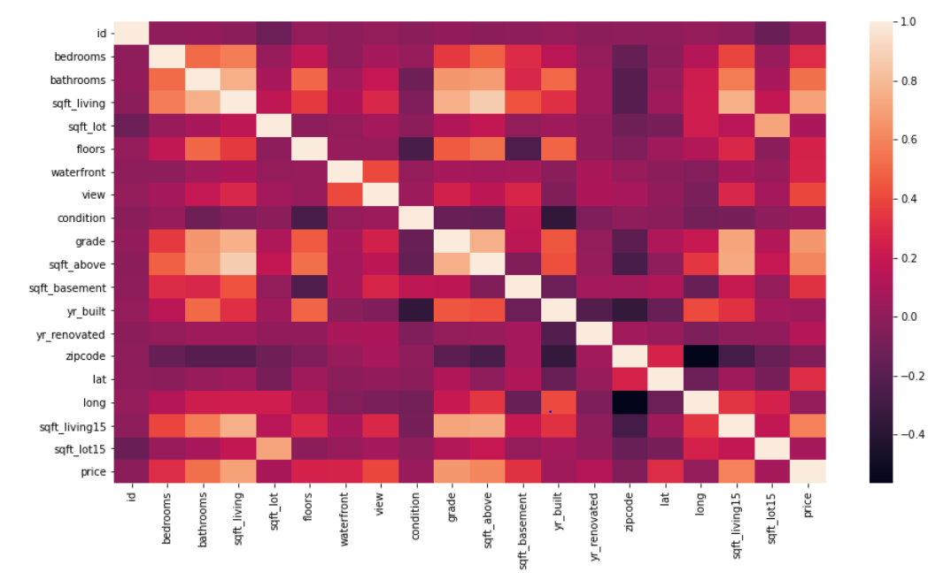
Correlation between dependent and independent variables

Slide 6
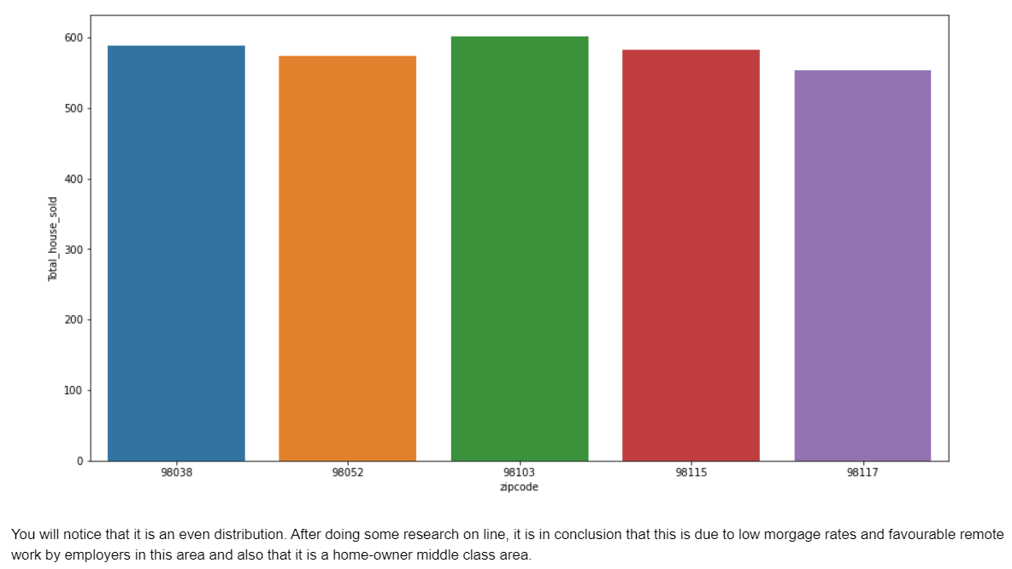
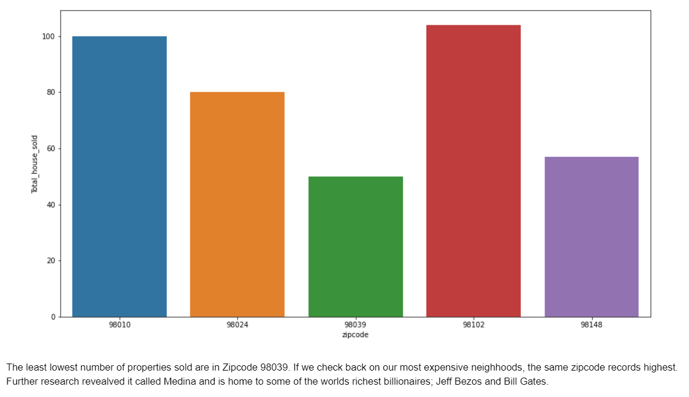
Top 5 highest selling zipcode by median price
lowest selling zipcode by median price

Slide 7
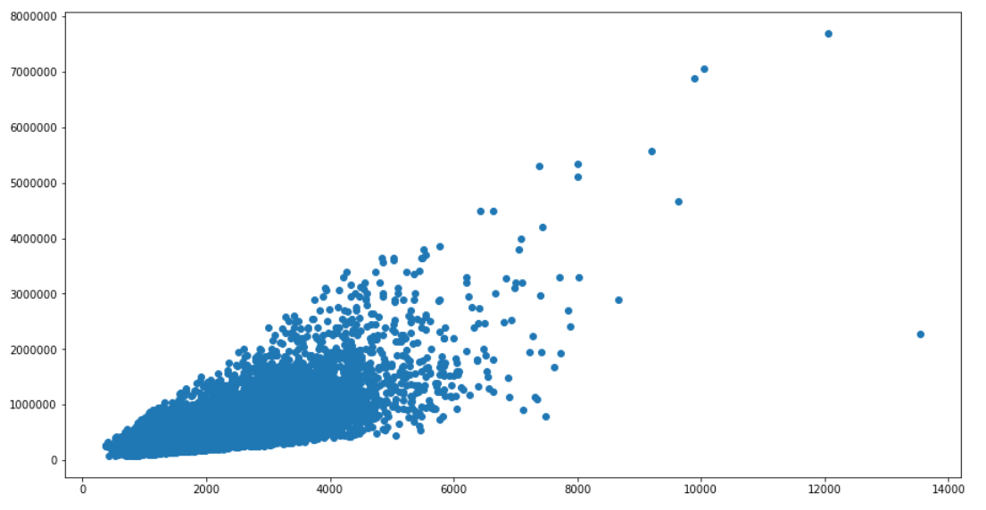
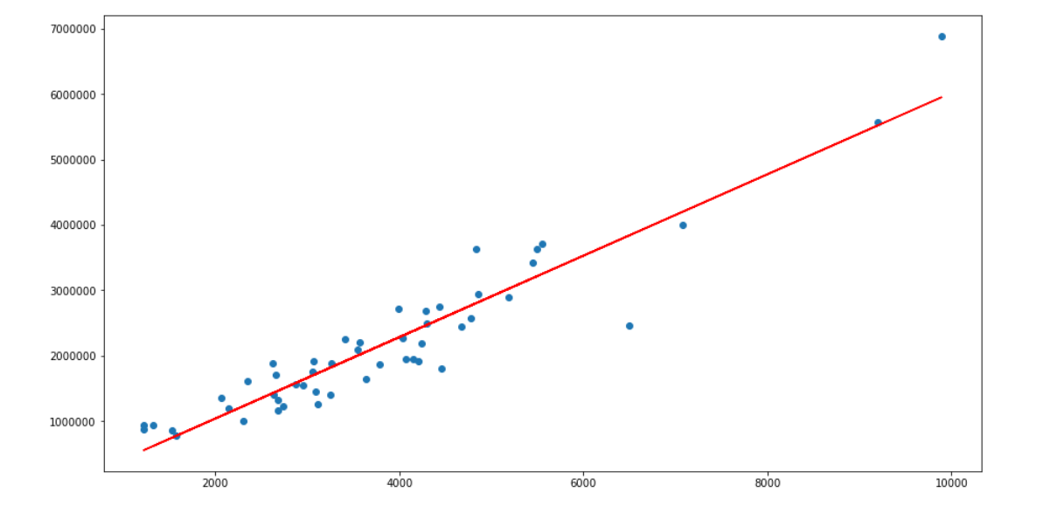
According to the data represented, one zipcode is an outlier.
The most expensive neighbourhood

Slide 8
The Algorithm
Simple Linear Regression was used to analyze the relationship between dependent and independent variable with a prediction score of 0.49%.
Multiple Linear Regression was used to predict the outcome using more independent variables with 0.88% and improved to 0.92% accuracy score.

Slide 9
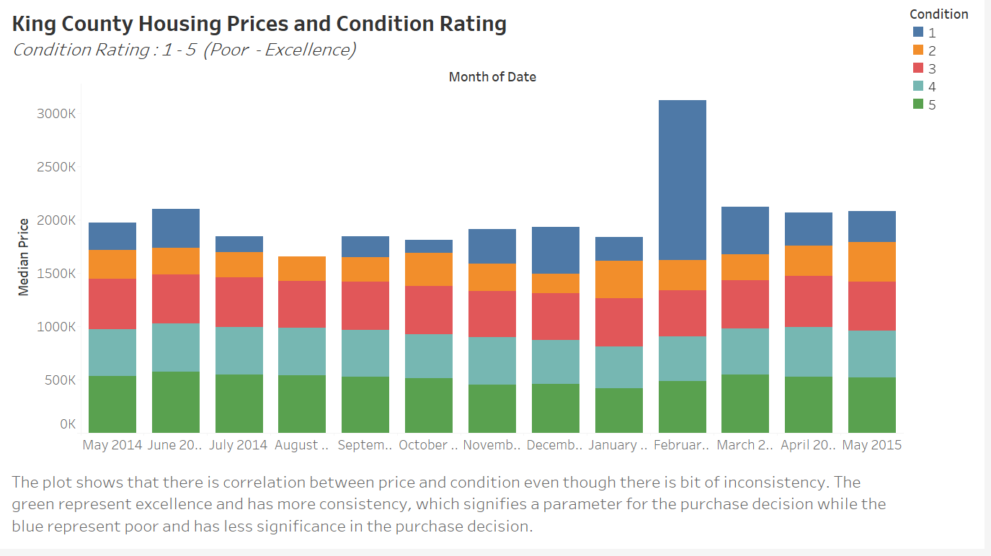

Slide 10
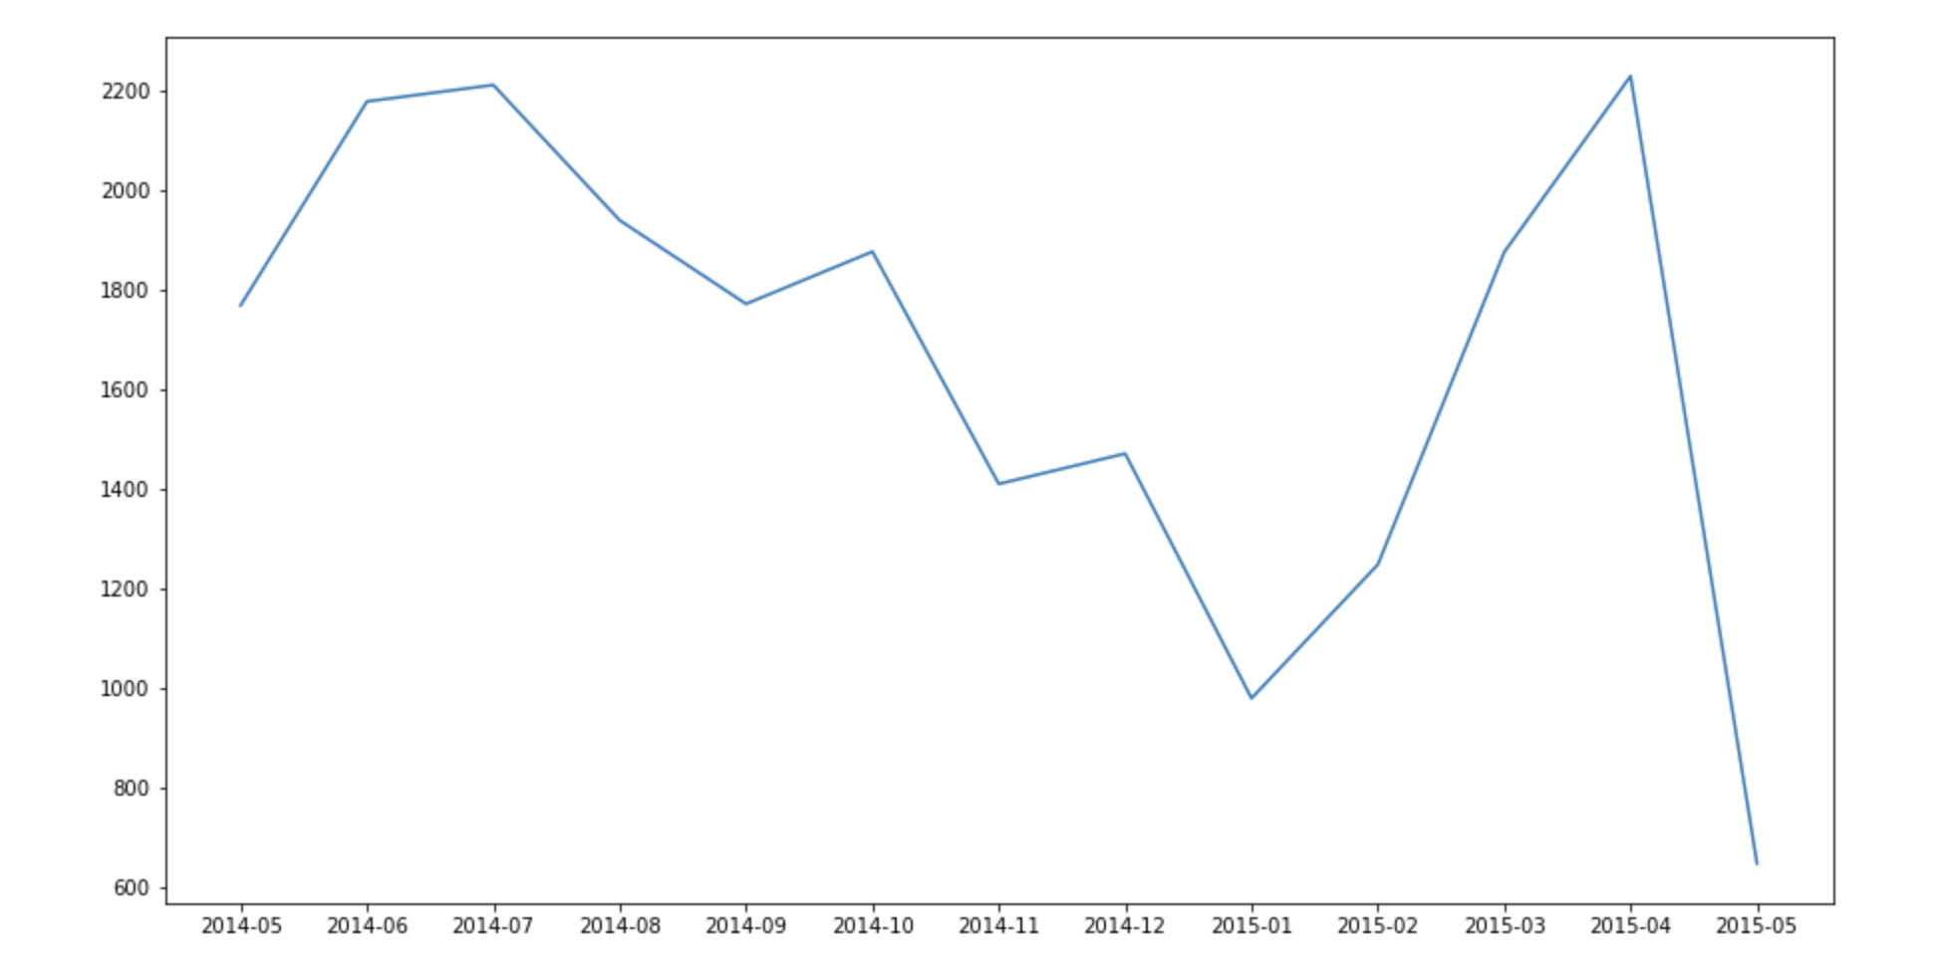
Visualizing the trend of number of properties sold for each month

Slide 11

Insights

Slide 12
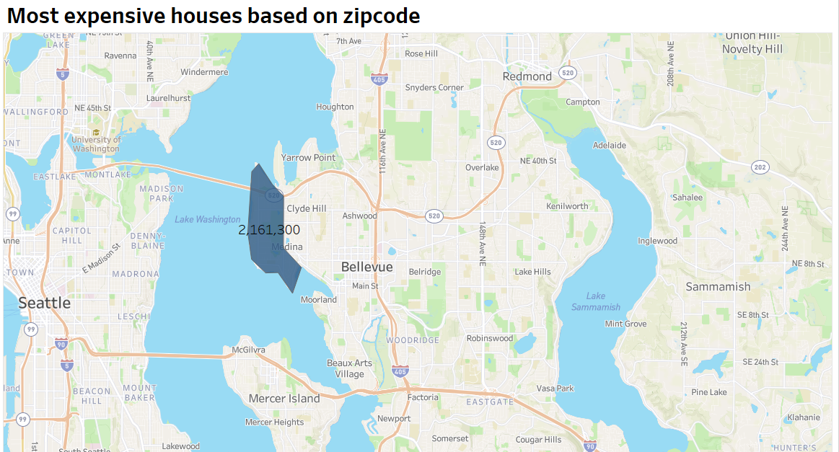

Slide 13
Challenges
Converting CSV
Fixing Tableau Dashboards
Accuracy Score

Slide 14

Thank you

